Slide 1
Hmong District 44th Annual Conference Nomination Committee 2nd Reading

Slide 2
Nomination Bylaws Kev Cai Xaiv Tsaa

Slide 3
KEVCAI LIJCHOJ NTXIV HUV HAUVPAUG KOOMHUM MOOB
PHAAJ III: HKM KEV TSWJFWM
6. TXUJCAI TSWJ KEV XAIVTSAA
Yog yuav taw ib leeg twg npe rua kev xaivtsaa yuavtsum nrug tug ntawd thaam ua ntej. Yog nwg txaus sab ua lawm maam taw nwg npe. Ib leeg tsuas muaj cai taw tau ib lub npe rua ib lub meejmom xwb.
Yog paab Kaavxwm Xaivtsaa tub nrug ib leeg twg thaam hab taw nwg npe rua ib lub meejmom (position), tabsis nwg tsi kaam rua puab taw, thov kuas nwg tsi txhob pub lwm tug (floor) taw nwg npe lug sis tw rua lub meejmom ntawd lawm.

Slide 4
Tug kws yuav taw npe lug xaiv ua Thawj Tsaavxwm yuavtsum yog ib tug Kws Xwbfwb. Tug kws yuav raug taw npe lug ua tug Canyaj yuavtsum tsi txhob yog xwbfwb.
Yog tug kws cov Kaavxwm Xaivtsaa tub taw npe lawm, lwm tug muajcai taw nwg npe lug rua lwm lub meejmom los tau, tabsis tug kws raug taw ntawd yuavtsum moog rhu npe tawm ntawm cov Kaavxwm Xaivtsaa es puab txhaj muaj sijhawm moog taw lwm tug lug hloov ua ntej kev tshaabxu zag ob. Tshwj lub meejmom Thawj Tsaavxwm lawm, lwm lub meejmom yog leejtwg tau suab ntau dlua tug ntawd yog tug tau. Yog has tas muaj ob tug tau suab sis npaug, yuavtsum muab obtug rov lug sistw dlua kuas ib tug tau.

Slide 5
Yog lub meejmom twg muaj ib leeg xwb kws tsi muaj lwm tug lug sistw nrug ces thov yuav suab pumzoo ntawm lub Rooj Saablaaj, tsuas tshwj lub meejmom Thawj Tsaavxwm.
Kev taw npe lug rua huv kev xaiv tsaa ua Tsaavxwm huv lub Rooj Tsaavxwm huv HKM (DEXCOM) tsuas muaj cai taw tau ib tug lug ntawm ib pawg ntseeg xwb hab paab kaavxwm nrug tug xwbfwb lossis txwjlaug thaam txug nwg lubneej ntseeg.
Cov kws ua dlejnum puvcaij (full time employee) huv HKM tsi muajcai raug taw npe lug rua cov meejmom Tsaavxwm (DEXCOM) tsuas tshwj lub meejmom Thawj Tsaavxwm hab Lwmthawj Tsaavxwm (Assistant DS) xwb. (RST 2013)

Slide 6
PHAAJ III: HKM KEV TSWJFWM
B. 2. Kev xaiv tug Thawj Tsaavxwm hab tug Lwm Thawj Tsaavxwm (Assistant DS) ca xaiv lawv le C&MA txujcai kws yeej muaj tseg lawm. Cov Tsaavxwm yim (8) leej, plaub (4) leeg yog kws xwbfwb hab plaub (4) leeg yog txwjlaug (Layman). Tug Canyaj yog ib tug txwjlaug. Tug Teev Ntawv yog ib tug kws xwbfwb. Ob tug muaj noobnyoog ua dlejnum ib zag twg plaub (4) lub xyoos hab ua tau ob (2) zag sis txuas xwb. Yog kem ib zag lawm ob tug muaj cai rov lug ua tau. Ntawm rau (6) tug Tsaavxwm (members at large) puab noobnyoog ua dlejnum ib zag twg yog ob (2) lub xyoos hab ua tau 3 zag sis txuas xwb. Yog has tas kem ib zag lawm puab muaj cai rov lug ua tau. (RST 2011)

Slide 7
Nomination Procedure for DEXCOM 2023

Slide 8
DEXCOM Nomination Procedure Adopted for this year.
The nominator must first inform the Nomination Committee of the nominee.
Upon informing the Nomination Committee of the nominee, the nominator will receive a “Reference Check” form from the Nomination Committee.
The nominator must complete the Reference Check with a pastor or elder from the nominee’s church.
After the Reference Check, the nominator will submit to the Nomination Committee the completed form for approval.
After receiving approval from the Nomination Committee, the Nomination Committee will provide the nominator with the Nomination Form to be completed by the nominee.
The Nomination Form must be returned to the Nomination Committee immediately after the nominator makes the nomination on the floor.
The nominator must nominate the nominee during open floor nomination for the nomination to be valid.
The nominator will have approximately 2 minutes to present the nominee to the floor during floor nomination.
The nominee will be listed on the ballots with the Nomination Committee's nominee on top follow by the order of nominees nominated from the floor.

Slide 9
Nominees for the office of District Executive Committee (DEXCOM):
Clergy: 1. Rev. Xiong Her (Kx. Nom Xyooj Hawj)
Denver Hmong Alliance Church, Denver, CO
Layman/Elder: 1. Mr. Txawj True Xiong (Kl. Txawj Rwg Xyooj)
Hmong American Alliance Church, Maplewood, MN
2. Mr. Chue Thao (Kl. Suav Tswb Thoj)
Living Stone Alliance Church, Appleton, WI

Slide 11
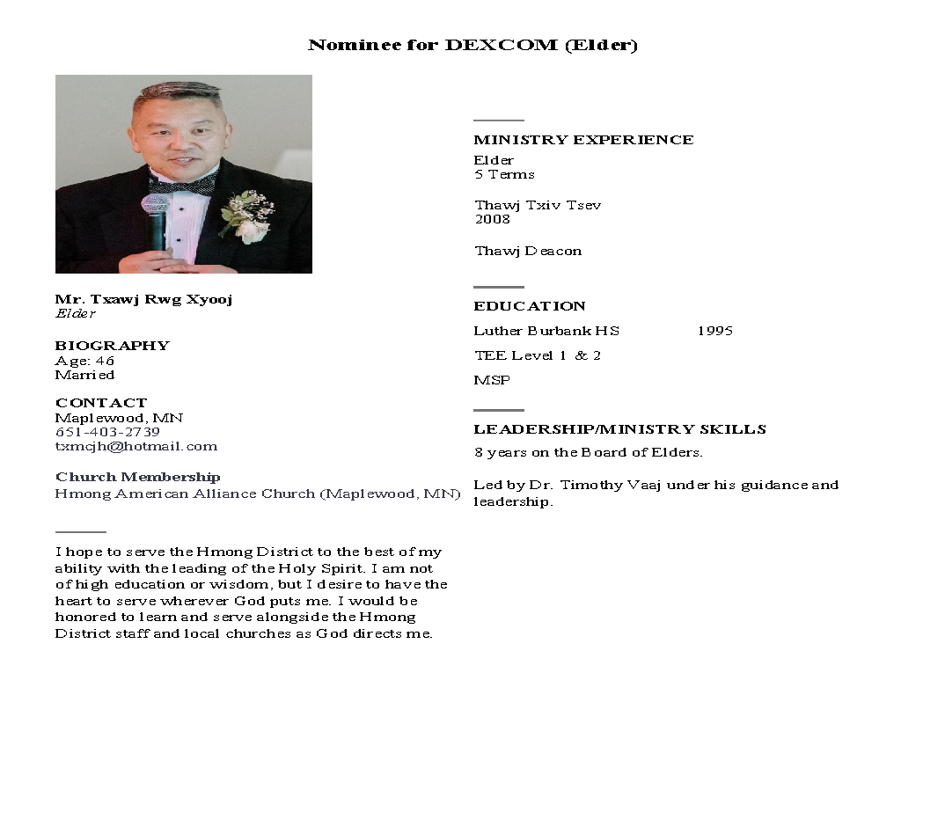

Slide 12
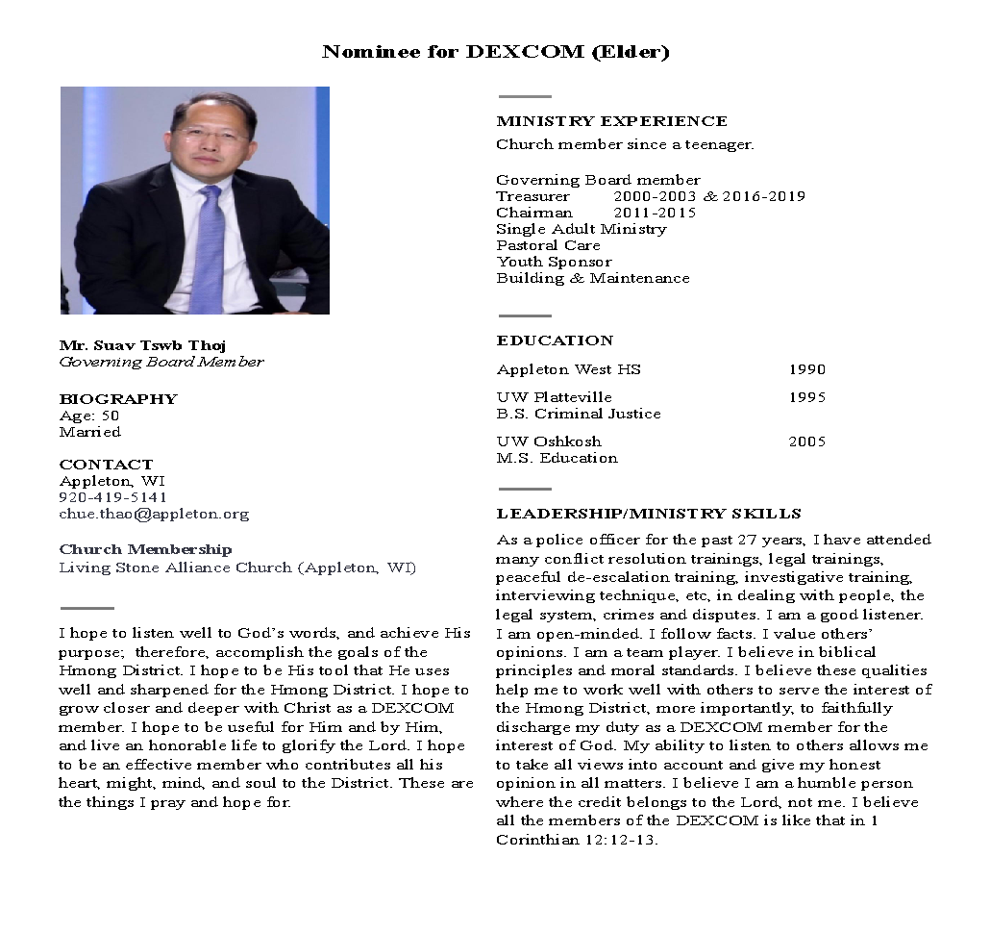

Slide 13
Nominations From the Floor

Slide 14
Nominations for DEXCOM (Clergy)

Slide 15
Nominations for DEXCOM (Elder)

